Slide 1
AWS Glue, Athena and Quick Sight

Slide 2
Agenda
Glue Data Catalog
Glue Jobs
Job Bookmarks
Athena
QuickSight Visualizations and Dashboards
QuickSight Security and Authentication

Slide 3
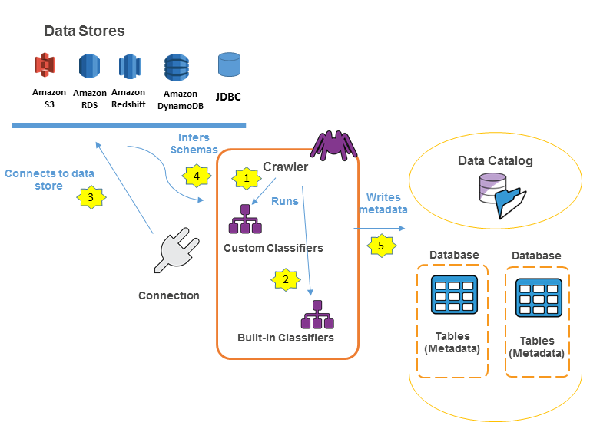
Glue Data Catalog
The AWS Glue Data Catalog consists of data references which can be applied as the reference source and target of extraction, transformation and loading jobs of AWS Glue.
AWS Glue Data Catalog provides index to the schema ,location run time metrics of the
It is very essential to catalogue the data for creating data ware houses and data lakes.
Credits: https://docs.aws.amazon.com/glue/latest/dg/populate-data-catalog.html/
Notes:
Reference for contents : https://docs.aws.amazon.com/glue/latest/dg/tables-described.html

Slide 4
A crawler populates AWS Glue Data Catalog in the following way:
A crawler can run any custom classifiers in the order of user specification to infer the format and schema of the data
The first custom classifier which recognize the structure of the used data will create the schema.
In case if custom classifier fails to match data’s schema ,in-built classifier try to match with existing data structures like JSON.
The crawler is connected to the data store as some data store needs crawler connection properties.
Metadata is written to data catalog by crawlers. Tables which hold metadata about data in data store.
Notes:
Reference for contents : https://docs.aws.amazon.com/glue/latest/dg/tables-described.html

Slide 5
AWS Glue Data Catalog
Your persistent metadata repository is the AWS Glue Data Catalog.
It's a managed service that allows you to store, annotate, and exchange metadata in the AWS Cloud in the same manner as an Apache Hive meta store would.
Per AWS region, each AWS account has one AWS Glue Data Catalog.
It creates a centralized location where various systems may store and retrieve metadata in order to maintain track of data in data silos and query and change the data.
Access to the data sources handled by the AWS Glue Data Catalog can be controlled using AWS Identity and Access Management (IAM) policies.
Notes:
Reference for contents : https://docs.aws.amazon.com/glue/latest/dg/components-overview.html

Slide 6
IAM policies allow you to determine which users have access to which data, regardless of where it is stored, in a clear and consistent manner.
With schema change monitoring and data access controls, the Data Catalog also provides extensive audit and governance features.
AWS services that make use of the AWS Glue Data Catalog include:
AWS lake formation
Amazon Athena
Amazon redshift spectrum
Amazon EMR
AWS Glue Data Catalog Client for Apache Hive Metastore
Notes:
Reference for contents : https://docs.aws.amazon.com/glue/latest/dg/components-overview.html

Slide 7
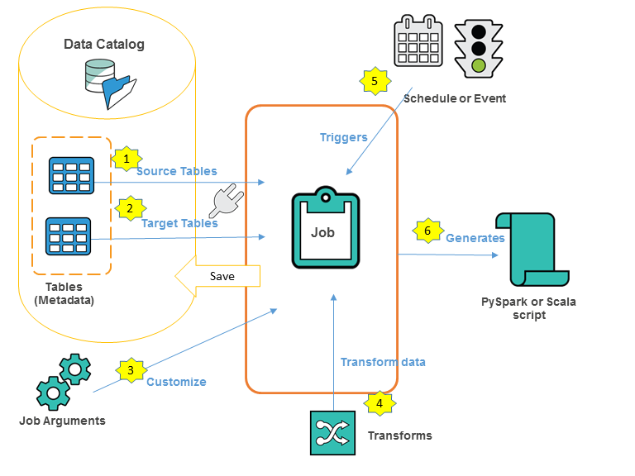
Glue Jobs
In AWS Glue, a job is the business reasoning that does the extract, transformation and load (ETL) processes.
AWS Glue executes a script when you start a task that pulls data from sources, transforms it, and inserts it into targets.
In the ETL area of the AWS Glue console, you may create jobs.
Credits : https://docs.aws.amazon.com/glue/latest/dg/author-job.html/
Notes:
Reference for contents : : https://docs.aws.amazon.com/glue/latest/dg/author-job.html

Slide 8
Authoring jobs in the AWS Glue console
Data Catalog must already have the tables that represent your data source. If your job necessitates the use of different data sources, you can do so simply changing the script.
You select a data target for your project. The tables that represent the data target can either be declared in your Data Catalog or created by your task as it runs.
By specifying arguments for your task and the resulting script, you can customize the job-processing environment.
AWS Glue builds a PySpark or Scala script based on your input.
You can customize the script to meet your own business requirements.
Notes:
Reference for contents : : https://docs.aws.amazon.com/glue/latest/dg/author-job.html#author-job-workflow

Slide 9
Using Job Bookmarks with the AWS Glue
Job bookmarks keep track of a job's status.
A job name and a version number are used to identify each instance of the state.
When a script calls job.init, it obtains its current state and always the most recent version.
When the user script calls job.commit, the state items are saved atomically.
From the arguments, the script obtains the job name and the control option for the job bookmarks.
Notes:
Reference for contents : https://docs.aws.amazon.com/glue/latest/dg/aws-glue-api-crawler-pyspark-extensions-get-resolved-options.html

Slide 10
The state elements in the job bookmark are data particular to the source, transformation, or sink.
Job bookmarks feature a run number, an attempt number, and a version number in addition to the state elements.
The job's run number is tracked, and the job's attempt number is kept track of how many times the job has been run.
Every successful run increments the job run number, which is a monotonically growing number.
The attempt number keeps track of each run's tries and is only updated when a run occurs after a failed attempt.
Notes:
Reference for contents : https://docs.aws.amazon.com/glue/latest/dg/aws-glue-api-crawler-pyspark-extensions-get-resolved-options.html

Slide 11
AWS Glue API’s
Jobs API - Jobs API describes jobs data types and contains APIs for working with jobs, job runs, and triggers in AWS Glue.
Jobs - The Jobs API describes the data types and API related to creating, updating, deleting, or viewing jobs in AWS Glue.
Job Runs - The Jobs Runs API describes the data types and API related to starting, stopping, or viewing job runs, and resetting job bookmarks, in AWS Glue.
Triggers - The Triggers API describes the data types and API related to creating, updating, or deleting, and starting and stopping job triggers in AWS Glue.
Notes:
Reference for contents : https://docs.aws.amazon.com/glue/latest/dg/aws-glue-api-jobs-job.html
Reference for contents : https://docs.aws.amazon.com/glue/latest/dg/aws-glue-api-jobs.html
Reference for contents : https://docs.aws.amazon.com/glue/latest/dg/aws-glue-api-jobs-runs.html

Slide 12
Special Parameters Used by AWS Glue jobs
--job language- scripting language (python/scala)
-- class –scala class that act as the entry point for scala script,if scala is used.
--scriptLocation – Amazon S3 location whereETL script is located
--extra-py-file –Before executing your script, AWS Glue adds new Python modules from Amazon S3 to the Python path.
--extra-jars - Before executing your script, AWS Glue adds extra Java.jar files to the Java classpath using Amazon S3.
Notes:
Reference for contents : https://docs.aws.amazon.com/glue/latest/dg/aws-glue-programming-etl-glue-arguments.html

Slide 13
Job Book Marks
Description
This command causes the job to change its state in order to retain track of previously processed data.
If your task has a source that supports job bookmarks, it will maintain track of processed data and process new data since the last checkpoint when it runs.
Disable
There are no job bookmarks, and the job always processes the whole dataset.
You are in charge of managing the results of prior task runs.
This is the default behaviour.
Notes:
Reference for contents : https://docs.aws.amazon.com/glue/latest/dg/monitor-continuations.html

Slide 14
Pause
Without altering the state of the last bookmark, process incremental data since the last successful run or data in the range defined by the following sub-options.
You are in charge of managing the results of prior task runs.
The following are the two sub-options: Job-bookmark-from and Job-bookmark-To
1. Job-bookmark-from
Is a run ID that represents all input handled up until and including the specified run ID.
The corresponding input is not taken into account.
Notes:
Reference for contents : https://docs.aws.amazon.com/glue/latest/dg/aws-glue-programming-etl-glue-arguments.html

Slide 15
2. Job-bookmark-to
Run ID that indicates all input handled up until and including the last successful run before and including the provided run ID.
The job processes the matching input, omitting the input identified by from value.
Any input received after this one is also not processed.
When this option set is selected, the job bookmark status is not changed.
Although the sub-options are optional, they must be specified if they are used.
Notes:
Reference for contents : https://docs.aws.amazon.com/glue/latest/dg/aws-glue-programming-etl-glue-arguments.html

Slide 16
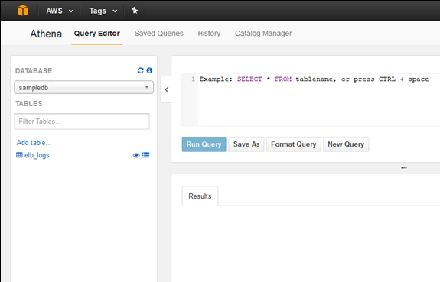
Amazon Athena
It is an interactive query service which makes analysis of data convenient in Amazon S3 by using standard SQL operation
It is serverless in nature, so no prior infrastructure is required to setup.
It can scale automatically, that is, execute queries parallelly so that the results are quick with large datasets and complicated queries
Credit: https://aws.amazon.com/blogs/aws/amazon-athena-interactive-sql-queries-for-data-in-amazon-s3/
Notes:
Reference for contents : https://docs.aws.amazon.com/athena/latest/ug/what-is.html
More Explanation : Using some of the actions in AWS Management Console, users can directly refer to the data stored in the Amazon S3 bucket post which standard SQL operations can be used to execute Ad-hoc queries and fetch results within few seconds.

Slide 17
With Athena, unstructured, semi-structured and structured data can be analyzed easily. It includes data formats like JSON,CSV and columnar data formats like Apache Parquet and ORC.
It can integrate with Amazon Quicksight for visualizing the data easily.
It can be used for generation of reports and exploration of data by using Business intelligence tool and SQL clients which are connected with ODBC or JDBC driver.
It also integrates with AWS Glue Data Catalog, which provides metadata store for the data stored in Amazon S3 bucket. This enables table creation and querying data in Athena according to the central metadata space available in AWS account.
Notes:
Reference for contents : https://docs.aws.amazon.com/athena/latest/ug/when-should-i-use-ate.html
More Explanation : With Athena, it is convenient to execute queries on data directly in Amazon S3 bucket without an overhead of formatting the data or managing the infrastructure.
It is useful to execute query on web logs to trouble shoot issues based on the performance of a website.

Slide 18
Integration of AWS services with Athena
Athena can be used to query data from many AWS services. These are:
AWS CloudFormation: Use the AWS Athena Data Catalog resource which specifies an Amazon Athena Data Catalog, it consists of name, description, type, tags and parameters. Users can also specify named queries with AWS CloudFormation and execute them in Athena
Amazon CloudTrail: CloudTrail logs can be used with Athena which is great way for introducing enhancements on analysis of AWS service activities.
Amazon CloudFront: Athena can be combined with Amazon CloudFront for querying the logs. Cloudfront CDN logs can be configured for exporting Web distribution access logs to Amazon S3.
Notes:
Reference for contents : https://docs.aws.amazon.com/athena/latest/ug/athena-aws-service-integrations.html
With Amazon Cloud Trail, queries can be used to recognize trends and further isolating activities by attributes like source of user and IP address. Tables can be created in order to run queries for getting logs directly from CloudTrail console and those tables can further be used to execute queries in Athena

Slide 19
Elastic Load Balancing: Load balancer logs of querying application enables users to observe the source of traffic, how many bytes are transferred to and from backend applications and check the latency.
AWS Glue Data Catalog: Athena combined with AWS Glue Data Catalog, provides metastore space for the user’s data stored in Amazon S3 buckets. It offers tables creation and querying the data in Athena according to central metastore space available in AWS.
AWS identity and Access Management: Actions in Athena APIs can be utilized in IAM permission policies. Examples of some of the actions are: BatchGetNamedQuery, CreateDataCatalog, CreateWorkGroup, DeletePreparedStatement, etc.
Notes:
Reference for contents : https://docs.aws.amazon.com/athena/latest/ug/athena-aws-service-integrations.html

Slide 20
Amazon QuickSight: Athena can be used with QuickSight in order to visualize data conveniently. It can be used for report generation and data exploration for Bussiness intelligence tools and SQL Client application connected through driver like JDBC or ODBC
Amazon S3 Inventory: Athena can be integrated with Amazon S3 buckets for using standard SQL operations.
AWS Step Functions: Athena can be invoked with AWS Step Functions. These functions can have control in selecting the AWS services directly by utilizing the Amazon States Language.
Notes:
Reference for contents : https://docs.aws.amazon.com/athena/latest/ug/athena-aws-service-integrations.html
More Explanation : Users can make use of Amazon Step Functions to start and stop the execution of queries, retrieving results, execute ad-hoc and scheduled data queries and then fetch results from data lakes available in Amazon S3 service.

Slide 21
Amazon System Manager Inventory: Amazon System Manager inventory combines with Athena to assist users in querying inventory data from various AWS accounts and regions.
Amazon Virtual Private Cloud: Amazon Virtual Private Cloud or AWS VPC helps creates a log which contains capture information regarding the IP traffic movement in between the network interfaces in a VPC. The logs can be queried in Athena to research on network traffic patterns and recognize the risks and threats over the Amazon Virtual Private Cloud network.
Notes:
Reference for contents : https://docs.aws.amazon.com/athena/latest/ug/athena-aws-service-integrations.html

Slide 22
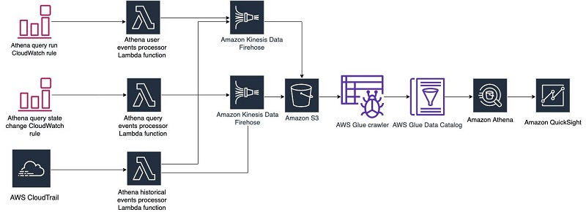
Athena Usage
Credit: https://aws.amazon.com/blogs/big-data/auditing-inspecting-and-visualizing-amazon-athena-usage-and-cost/
Notes:
Reference for contents : https://aws.amazon.com/blogs/big-data/auditing-inspecting-and-visualizing-amazon-athena-usage-and-cost/

Slide 23
QuickSight Visualizations and Dashboards
Overview on Amazon QuickSight
It is cloud scale based business intelligence service that users can use to deliver simple insights which are easy to understand for the people who are working with users.
It makes a connection with the user’s data in cloud and integrates from various resources.
Within a single data dashboard, QuickSight has an ability to include, third party data, AWS data, spreadsheet data, big data, B2B data, SaaS data and much more.
Notes:
Reference for contents : https://docs.aws.amazon.com/quicksight/latest/user/welcome.html
More Explanation : QuickSight is a fully managed cloud based services which offers enterprise level security, buit-in redundancy and global availability.
It offers management tools for users that they need scale from few users to thousands of users without the need of setting up infrastructure for deploying and management.
It provides decision makers to explore and understand information in an interactive user interface space.

Slide 24
Benefits of using QuickSight
It offers a memory engine known as SPICE which responds with powerful speed.
No additional costs of licenses
It asks for very low cost for ownership
Collaboration with analytics with no requirement to install any additional application.
Integration of large amount of data into single analysis.
Analysis report can be published and shared within a dashboard
Many features can be controlled in the dashboard.
Notes:
Reference for contents : https://docs.aws.amazon.com/quicksight/latest/user/welcome.html

Slide 25
QuickSight offers more Enterprise edition features for its advanced users:
It saves lot of time and cost with the customizable and automatic data insights which is supported by Machine Learning. It enables the enterprises to carry out the following tasks without the need of an extra knowledge on machine learning:
It automatically makes reliable and meaningful forecasts
It has an ability of automatically detecting outliers.
Data translation into simple narratives such as titles and headlines for the user’s dashboard.
Encourages users to make QuickSight a part of the user’s applications and websites by hosting dashboard sessions and embedded console analytics.
Notes:
Reference for contents : https://docs.aws.amazon.com/quicksight/latest/user/welcome.html

Slide 26
Working with Amazon QuickSight
The workflow of the analysis usually seems to be:
Creating new analysis
Adding new or existing datasets
First chart can be created by using fields. It automatically gives suggestion to users for powerful visualization
More tables, charts, insights can be added to the analysis.
Analysis can then be published on dashboard so that other users can also view it
Notes:
Reference for contents : https://docs.aws.amazon.com/quicksight/latest/user/how-quicksight-works.html

Slide 27
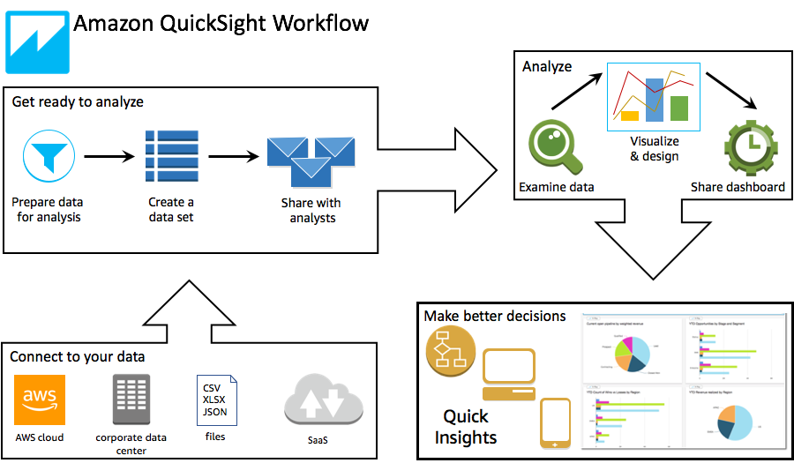
Workflow followed in Amazon QuickSight
Credit: https://docs.aws.amazon.com/quicksight/latest/user/how-quicksight-works.html
Notes:
Reference for contents : https://docs.aws.amazon.com/quicksight/latest/user/how-quicksight-works.html

Slide 28
Interactive Dashboards in Amazon QuickSight
Data dashboard contains a collection of table, charts, figures, graphs and insights.
It’s similar to a newspaper which showcases all the information at one place along with graphics.
Dashboards offers great variety of designs which depends on the users requirements, how thwy are willing to use those design features and what kind of analytics they want to do with it.
With QuickSight, users can interact with the data on their webpage or even with their mobile devices.
Dashboards are designed by data scientists whereas publishers fill the dashboards with interesting data along with interactive visualization of data.
Notes:
Reference for contents : https://docs.aws.amazon.com/quicksight/latest/user/using-dashboards.html
More Explanation : When a dashboard is viewed, most recent data is displayed on it. As the users interact with the features and functionalities on the screen, any changes that are made by them reflect in the dashboard which is only visible to the current user and is not visible to others.
Therefore, it provides the privacy as well for a device.

Slide 29
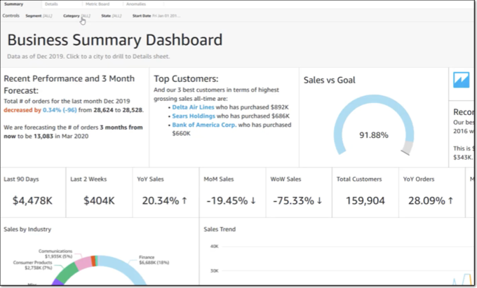
Exploring Dashboards
The dashboards consists of the following features:
Menu Bar
Dashboard Sheets
Filter Menu
Control Palette
Dashboard Title
Dashboard Widgets
Credit: https://docs.aws.amazon.com/quicksight/latest/user/exploring-dashboards.html
Notes:
Reference for contents : https://docs.aws.amazon.com/quicksight/latest/user/exploring-dashboards.html

Slide 30
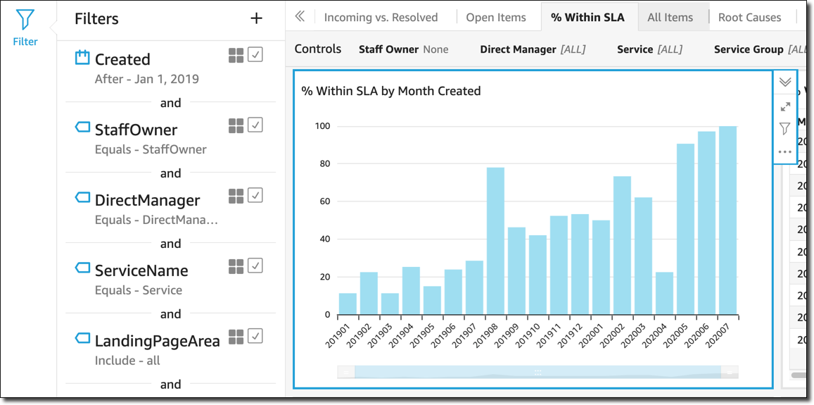
Adding Filters in Dashboards
Credit: https://docs.aws.amazon.com/quicksight/latest/user/exploring-dashboards.html
Notes:
Reference for contents : https://docs.aws.amazon.com/quicksight/latest/user/exploring-dashboards.html

Slide 31
QuickSight Security and Authentication
QuickSight provides a secure platform that allows users to circulate dashboards and insights to many thousands users. Security of cloud is crucial and of highest priority at AWS.
There is model defined by AWS which is known as shared responsibility model and it includes security of the cloud and security in the cloud
Security of the cloud: It’s AWS responsibility for protecting and providing security to the infrastructure provided by AWS which runs the AWS services.
Security in the cloud: Users also hold the responsibility of other parameters like their organization’s requirements, sensitivity of the data, valid laws and regulations.
Notes:
Reference for contents : https://docs.aws.amazon.com/quicksight/latest/user/security.html

Slide 32
Best Security Practices followed in Amazon QuickSight
QuickSight provides various security features that should be taken into account as the users implement and develop their own security policies. Following considerations might be useful considerations for applying best security practices:
SSL: It can be used for connection with the databases when users are using public networks
VPC: Virtual Private Cloud can be used for private and secure communication with the data resources
Firewall: To enable users for accessing Amazon QuickSight, turn on the access to HTTPS WSS (WebSockets Secure) sockets
Enhanced Security: It provides features like storing data in SPICE (built in memory)
Notes:
Reference for contents : https://docs.aws.amazon.com/quicksight/latest/user/best-practices-security.html

Slide 33
Authenticating with Identities
The Authentication is how a user signs into AWS account using their identity credentials. Users are authenticated first to use any of the AWS services. They must be signed is as any of the following users:
AWS account root user
IAM user
Assuming an IAM role
Notes:
Reference for contents : https://docs.aws.amazon.com/quicksight/latest/user/security_iam_authentication.html

